Slide 1
AFF: No eternal United
- The Split of The Internet
Notes:
----- 会议笔记(2/6/14 13:14) -----

Slide 2
The Topic
Today, there is one ubiquitous data network for consumers that is called the Internet.
However, we assert that one size cannot fit all. Specifically, in 20 years, there will be multiple distinct data networks for consumers that are incompatible with and disconnected from one another.
These networks will serve different purposes and/or have different properties.
Our Point of View
Internet will divide into several data networks with different functions and parameters.

Slide 3
Definitions of Terms
Internet
a global system of interconnected computer network that use the standard Internet protocol suite (TCP/IP) to serve several billion users worldwide.
Size
Not Only refer to the SCALE
But Also : Structure & Overall Performance & Network Protocol
Consumer
INCLUDE ALL People & Organization & Institute
EXCEPT Military & Financial Industry.

Slide 4
Part I : One Protocol for Multiple Purpose
Purpose I : Download Software
- Malicious (User Cheating on End Host)
Purpose II : Web Application
- Slow start is BAD for short lived flows
Purpose III : Streaming Media
- Unstable Transmission Rate
Purpose IV : ……

Slide 5
Part II : Complexity of Topology
Brief history of Internet
In 1969, U.S. Department of Defense developed Advanced Research Projects Agency Network, also known as ARPANET.
In 1970s, the researchers in Europe developed JANET. In 1984, ARPANET and JANET linked together.
In 1989, internet opened to commercial consumer, and companies that provide online service began to appear.
In 1990, World Wide Web began to popularize in the world.
In 1995, NSF handed the management of the internet to network carriers.
In the same year, personal computer began to popularize in the world.

Slide 6
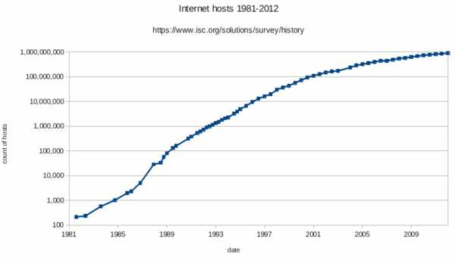
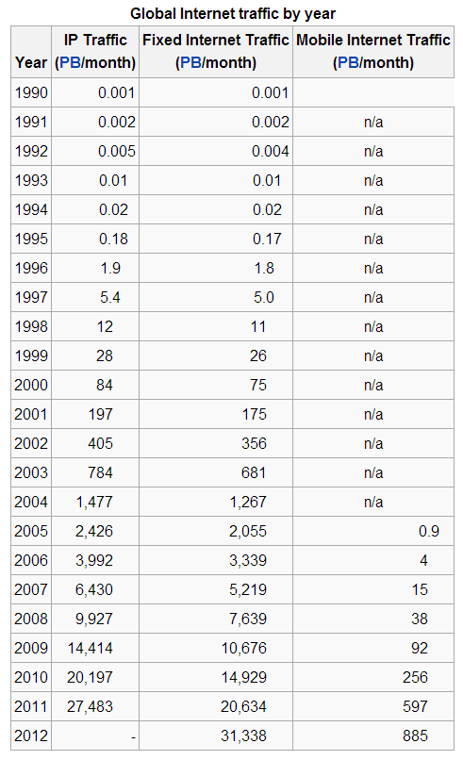
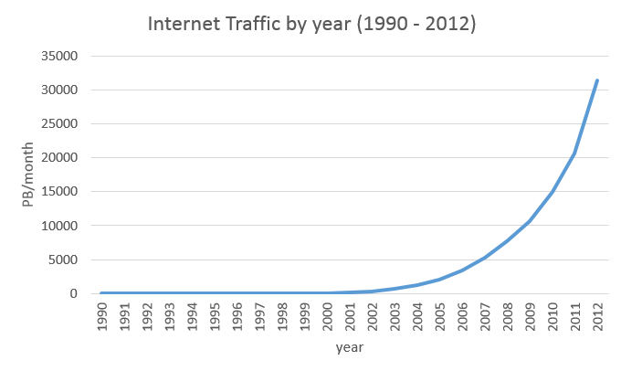
The host number of Internet (1981-2012)
Global Internet Traffic by year (1990-2012)

Slide 7
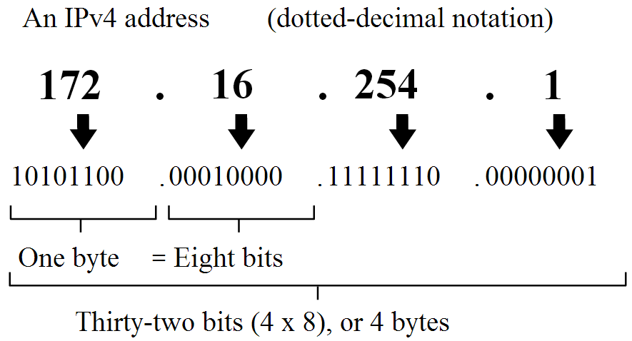
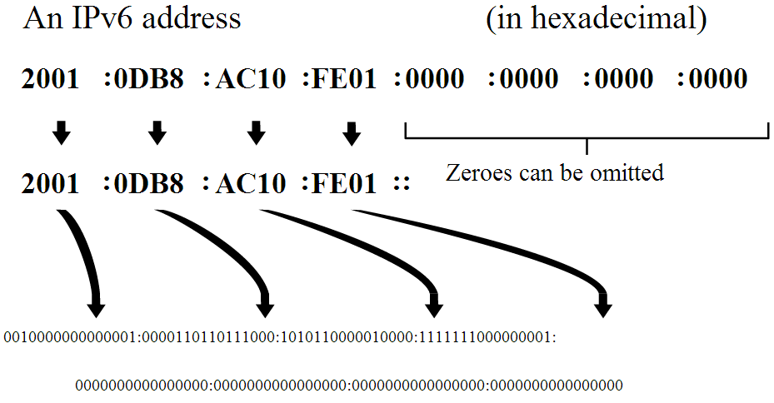
IPV4 vs IPV6

Slide 8


Part III : Security
Government Information Data
Controlled by America
PRISM by NSA
Root Name Server were attacked
Personal Information Data
Fraud in Personal Bank Account
Disclosure of Private Information

Slide 9


Conclusion - One Internet Must Be Splited
Compromised performance for multiple purpose
Vulnerability of Current Network System
No Backup Network when Collapse
American government has invested 3.5 billion to the research of next generation of network that is consisted of multiple sub-networks !

Slide 10
Thank You

